Slide 1
Technical Debt & Refactoring
Masud Rahman
Contact: masud.rahman@usask.ca
CMPT 370
University of Saskatchewan

Slide 2


Recap on Tutorials
SDLC Phases (6)
Requirement Gathering & Analysis
UML
System Design
Database
Implementation & Coding
Source code documentation
Version control systems
Software Testing
Unit & Integration testing
System Deployment
Build tools
Software Maintenance & Evolution
Clone detection
Technical Debt & Refactoring

Slide 3
Talk Outline
Part I: Technical Debt
Part II: Refactoring
Part III: Tool Demo

Slide 4
Part I: Technical Debt

Slide 5
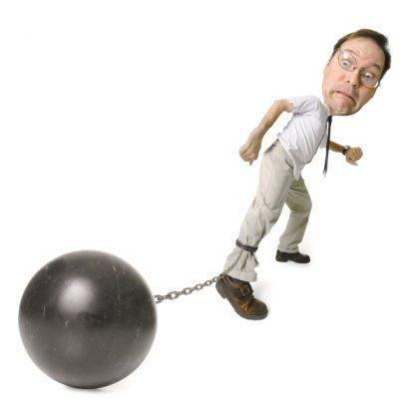
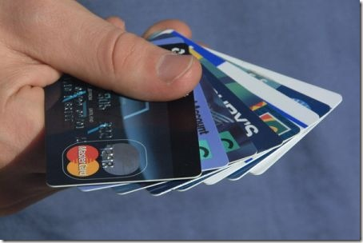
The Debt Metaphor
Use a credit card to obtain something now (short term)
Pay for it later - financial debt (future payment due)
Plus interest (the cost of being able to do this)

Slide 6
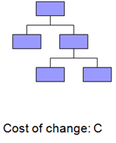
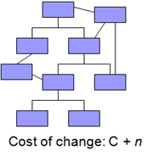
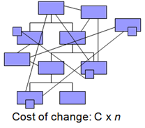
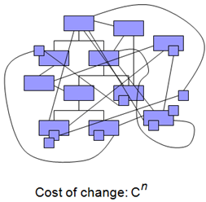
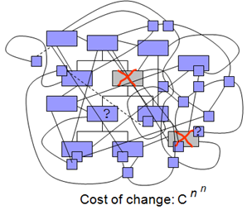
Premise
“All known compound objects decay and become more complex with the passage of time. Software is no exception.”

Slide 7
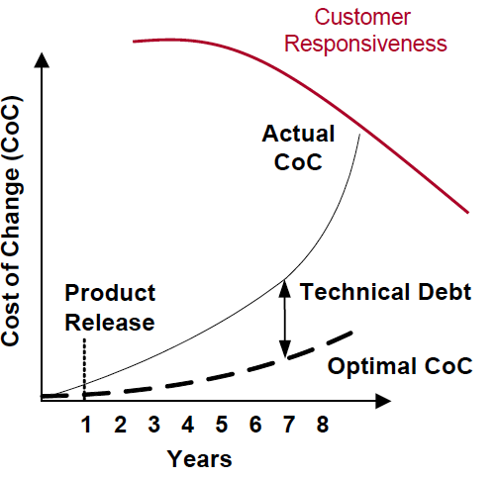
Why Do We Care?

Slide 8

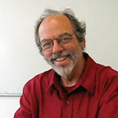
What is Technical Debt?
“Technical Debt” term coined by Ward Cunningham
in 1992
A guy from Smalltalk from the 80's onward
Choosing a design or construction approach
that is expedient, but increases complexity and is costlier in the long term

Slide 9
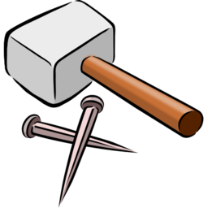
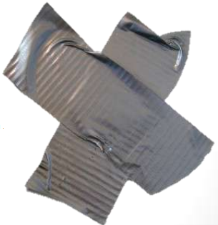
Technical Debt (Continued)
Preserver architecture
Follow good programming practices
Update documentations
Test thoroughly
As quick as possible
With as few resources as possible

Slide 10
Did You Have these Conversations?
Do not worry about documentation now
Let’s finish the testing in the next release.
Its Ok for now, but we will refactor later
Only Carl can change this code.
I know if I touch that code everything else breaks!
If yes, then your project has technical debt
ToDo/FixMe: this should be fixed before release
Does anybody know where we store the database access password?
Let’s just copy and paste this part
The release is coming up, so just get it done!

Slide 11
Technical Debt Types
Technical Debt
Code Debt
Design Debt
Test Debt
Documentation Debt
Static analysis tool violations
Design smells
Lack of tests
No documents for important concerns
Inconsistent coding styles
Design rule violations
Inadequate test coverage
Outdated documentation

Slide 12
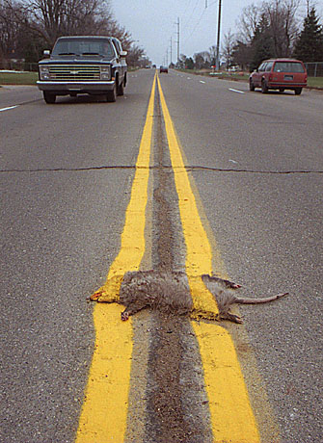
What is a Smell?
Smells are certain structures in the code that suggest (sometimes they scream for) the possibility of refactoring

Slide 13
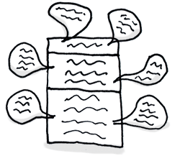
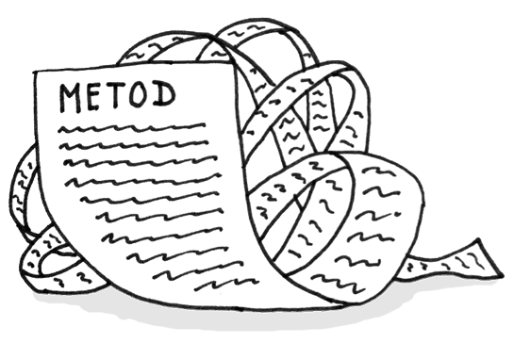
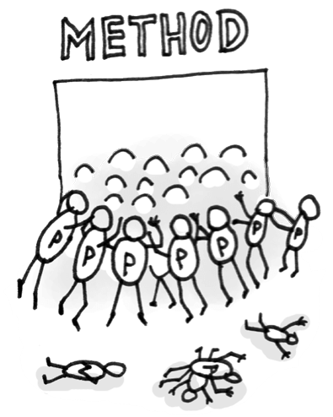
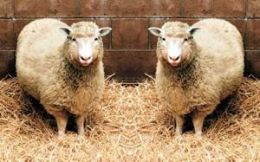
Code Smells & Static Analysis Rule Violations
Comments -- obscure comments
Long method – Too long
Long parameter list – Restrict the size
Duplicate code– a.k.a., code clones

Slide 14
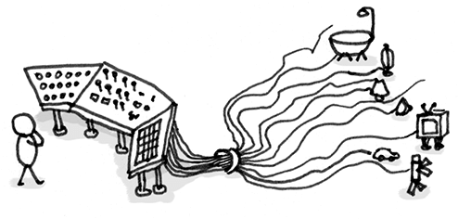
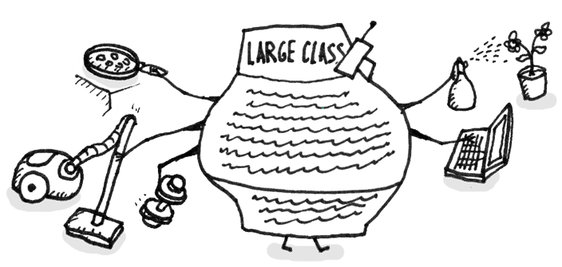
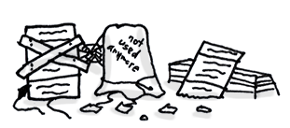
Code Smells & Static Analysis Rule Violations
Conditional complexity – watch out for nested blocks, Cyclomatic complexity
Large class -- avoid large class
Dead Code – that is not used at all.

Slide 15
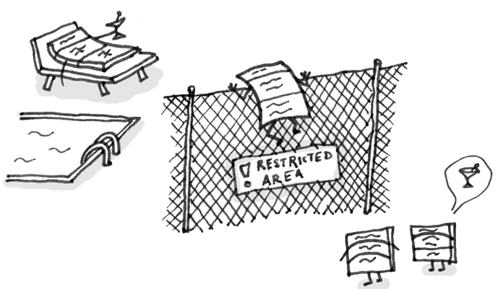
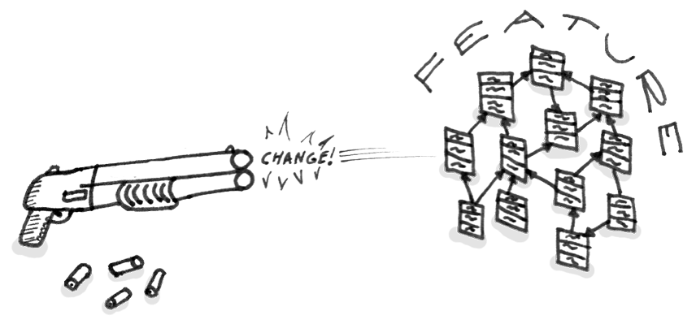
Code Smell & Static Analysis Rule Violations
Feature Envy – method from one class access another class excessively.
Shotgun Surgery – change in one class should not create cascading effect
More on: https://sourcemaking.com/refactoring/smells

Slide 16
Design Smells & Anti-patterns
Wolf Ticket: Product that claims openness and conformance to standards that have no enforceable meaning.
Swiss Army Knife: Jack of all trades, master of none.
Reinvent the Wheel: Do we need more wheels?
The Grand Old Duke of York: No knowledge of abstraction, rather favor implementations.
Stovepipe Enterprise: System has ad hoc architecture and requires frequent repair.

Slide 17
Design Smells & Anti-patterns
Cyclic dependency: Two components depends on each other.
Unstable Dependency: Component depends on other which is less stable.
Ambiguous Interface: Only a single generic interface.
God Component: Excessively large component.
Feature Concentration: Single component realizes more than features.
Scattered Functionality: Multiple components are responsible for realizing the same high-level concern
Dense Structure: Excessive and dense dependencies without any particular structure.

Slide 18
Part II: Refactoring

Slide 19
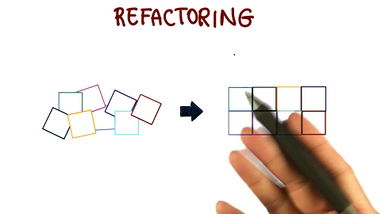
What is Refactoring?
Refactoring is changing a software system by improving its internal structure without changing its external behavior

Slide 20
Why Refactoring?
Maintainability
Extensibility
Design quality
Sustainability
Testability
Easy bug localization
Refactoring
Readability
Understandability
Structural simplicity

Slide 21


Technical Debt
T or F: all technical debt is bad and should be avoided at all costs.

Slide 22
Refactoring Principles
Preserve Correctness
One step at a time
Frequent Testing
Steps of Refactoring:
Pareto analysis helps to identify heavily used or time consuming code. 80/20 rules.
Refactoring begins by designing a solid set of tests for the section analysis.
Identify problems in code by review using bad smells of code.
Introduce a refactoring and test.

Slide 23
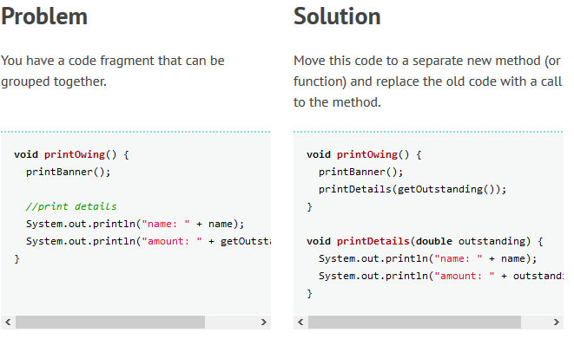
Refactoring Examples: Extract Method
Long Method

Slide 24
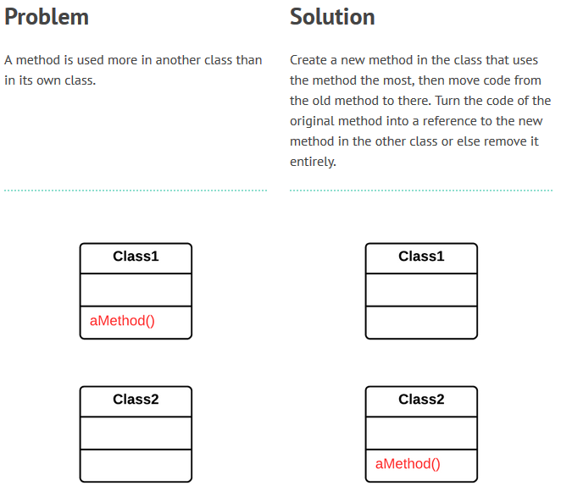
Move Method
Feature Envy

Slide 25
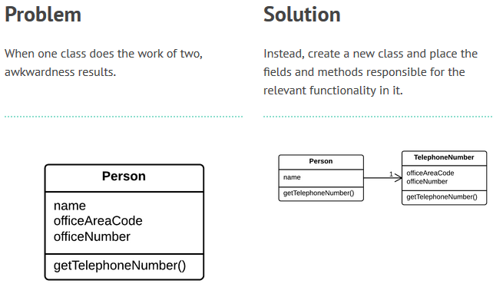
Extract Class
Long/God class

Slide 26
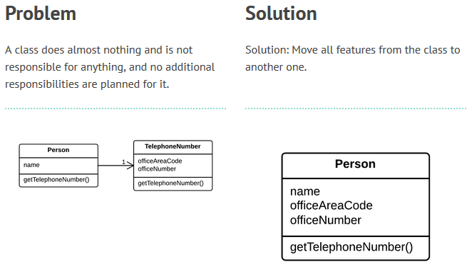
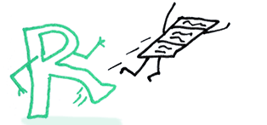
Inline Class
Lazy class
Dead code

Slide 27
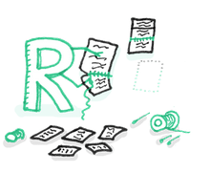
Treatment for Shotgun Surgery

Slide 28
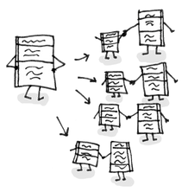
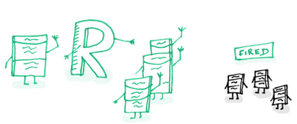
Treatment for Middle Man

Slide 29
Encapsulate Downcast: A method returns an object that needs to be down casted by its callers. Refactor by moving the downcast to within the method.
Reading
Object lastReading() {
return readings.lastElement();
}
Reading lastReading() {
return (Reading) readings.lastElement();
}

Slide 30
Consolidate Conditional Expression: You have a sequence of conditional tests with the same result. Refactor by combining them into a single conditional expression and extract it.
double disabilityAmount() {
if (_seniority < 2) return 0;
if (_monthsDisabled > 12) return 0;
if (_isPartTime) return 0;
// compute the disability amount
double disabilityAmount() {
if (isNotEligibleForDisability()) return 0;
// compute the disability amount

Slide 31
Rename Method: The name of a method does not reveal its purpose. Refactor it by changing the name of the method.
int getInvCdtLmt(){
…
}
int getInvoiceableCreditLimit(){
…
}

Slide 32
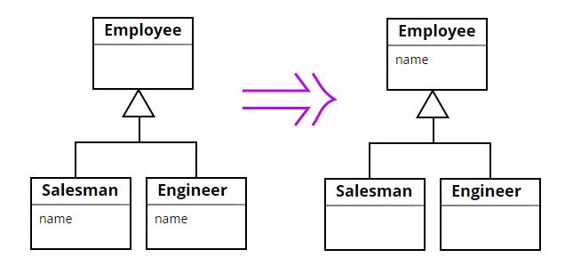
Pull Up Field: Two subclasses have the same field. Refactor it by moving the field to the superclass.

Slide 33
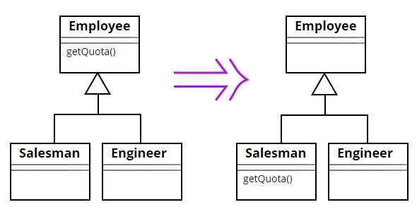
Push Down Method: Behavior on a superclass is relevant only for some of its subclasses. Refactor it by moving it to those subclasses.

Slide 34
Further Resources
https://blog.codinghorror.com/code-smells/
https://sourcemaking.com/refactoring/smells
http://www.designsmells.com/articles/does-your-architecture-smell/
https://en.wikipedia.org/wiki/Design_smell
Refactoring for Design Smells, ICSE 2014
Managing Technical Debt using Agile, Michael Hall, Three Beacons.
Identifying and Managing Technical Debt, Nico Zazworka, Fraunhofer, USA.
Refactoring, Sunil Manoharan, NJIT

Slide 35
Part III: Tool Demo

Slide 36
Tools
Java
FindBug: http://findbugs.sourceforge.net/
PMD: https://pmd.github.io/
CheckStyle: http://checkstyle.sourceforge.net/
C#.net
ReSharper: http://www.jetbrains.com/resharper/
CodeRush: http://go.devexpress.com/CodeRushX.aspx
Multi-language Framework
SonarQube: https://www.sonarqube.org/

Slide 37
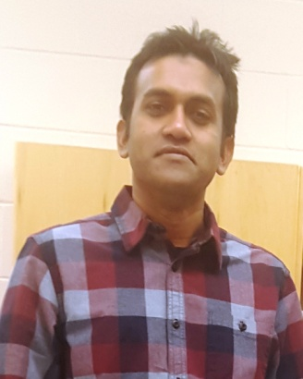
Thank You!! Questions?
Masud Rahman
masud.rahman@usask.ca

